Slide 1
Bingo Game
JAVA MiniProject
Project Guide: Dr. Sharmila Ponnoran

Slide 2
Group Members
Shreya Patil
Mandaar Pawar
Aarya Walve

Slide 3
Topics
System Requirements
Introduction
Screenshots
Future Scope
Conclusion

Slide 4
System Requirements
Hardware:
Processor: A modern multi-core processor, such as Intel Core i3 having 2 cores or equivalent.
RAM: At least 8GB.
Storage: Sufficient disk space to run JDK and other resource intensive IDE like VSCode or IntelliJ.

Slide 5
Software:
OS: Windows 10 or newer. Linux Ubuntu 20.04 or later.
JDK: Version 19 or newer.
IDE: Either run it in Command Prompt(cmd) or in IDE like VSCode or IntelliJ.

Slide 6
Introduction
Creating a Java program for a bingo game is an excellent way to digitalize and streamline the traditional bingo experience.
Bingo is a game known for its simplicity, social engagement, and chance-based entertainment. By developing a Java-based bingo program, you can make the game more accessible and enjoyable for a wide audience, whether they are playing in a physical location or online.
This program can help in automating the number calling process, verifying winning cards, and even generating randomized bingo cards for players. Moreover, it can serve educational purposes, as well as promoting community interaction.

Slide 7
Java's versatility and platform independence make it a suitable choice for developing bingo games that can run on various devices, making it convenient and accessible to a broad range of users.
In essence, a Java-based bingo game brings a traditional and sociable game into the digital platform, making it more inclusive and user-friendly for all players.

Slide 8
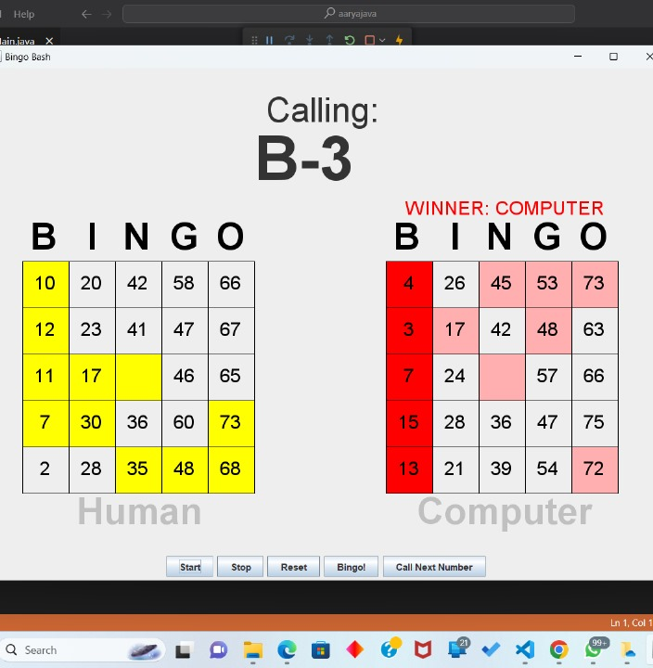
Screenshots
Of Bingo Game

Slide 9
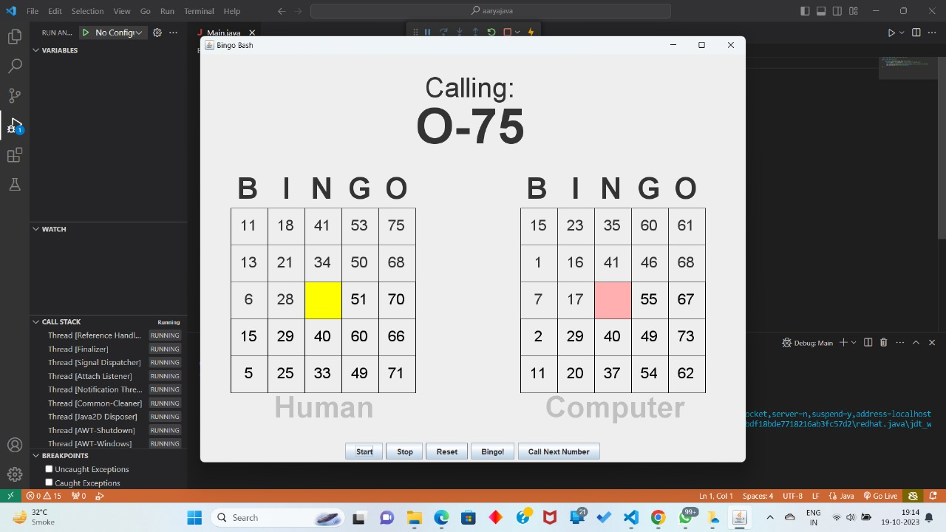

Slide 10
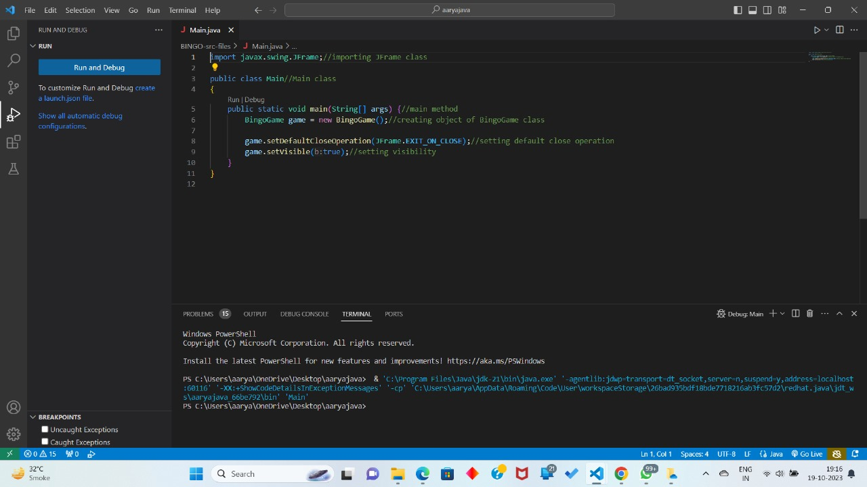

Slide 11
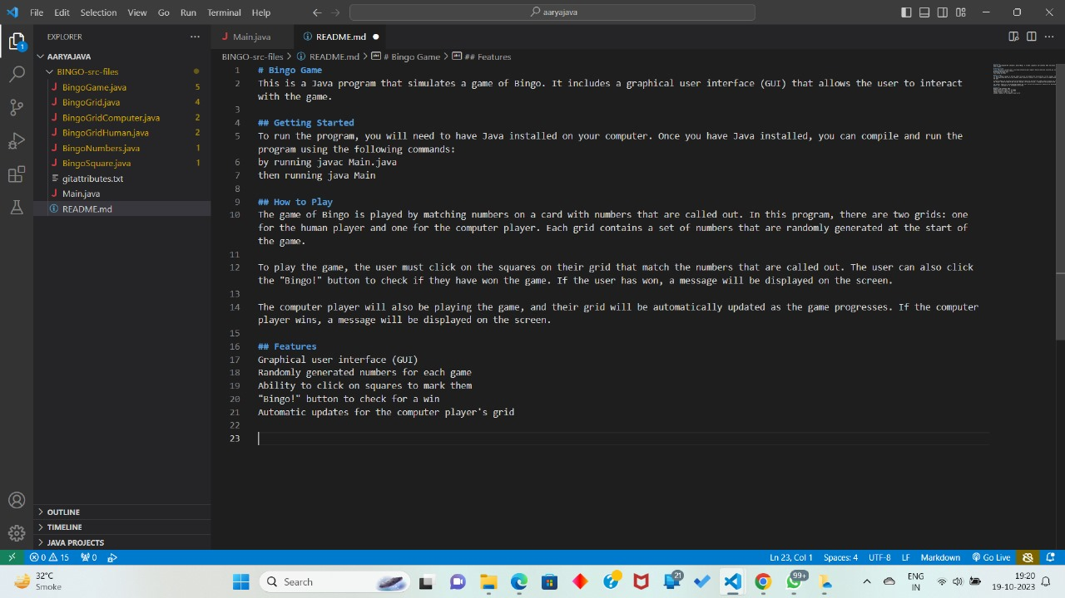

Slide 12
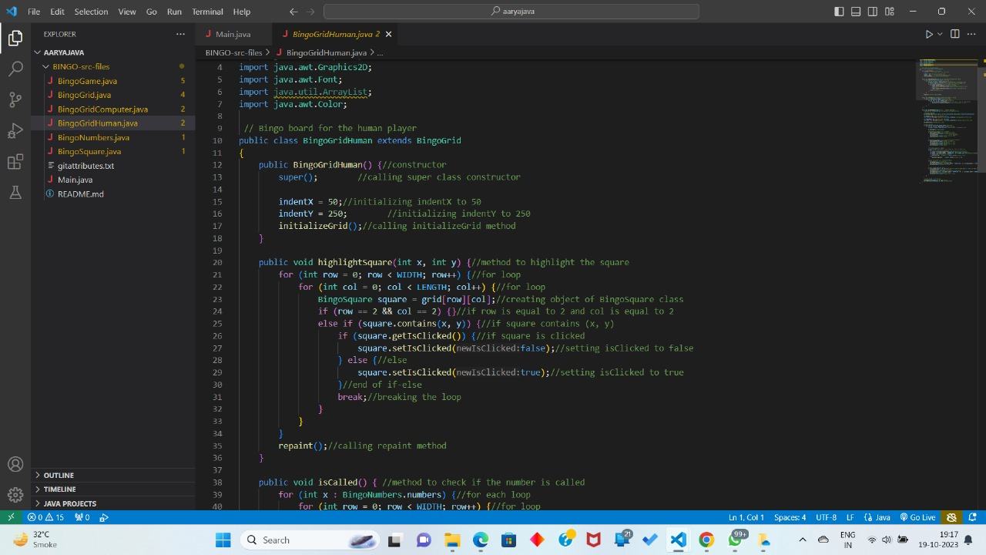

Slide 13
Future Scope
Of Bingo Game
1. Enhanced User Experience:
- Improve the user interface for a more visually appealing and user-friendly experience.
- Add sound effects and animations to make the game more engaging.
2. Multiplayer and Online Features:
- Enable online multiplayer functionality, allowing players to participate from different locations.
- Implement chat features to facilitate social interaction during the game.

Slide 14
4. Statistics and History:
- Create a feature that tracks player statistics, such as the number of games won and cards played.
- Implement a game history log, so players can review their previous games.
5. Mobile and Cross-Platform Compatibility:
- Develop mobile versions of the Java program for Android and iOS platforms.
- Ensure cross-platform compatibility to allow players on different devices to play together seamlessly.

Slide 15
6. Accessibility Features:
- Implement accessibility features for players with disabilities, including options for voice commands and screen readers.
7. Internationalization & More accessible:
- Translate the program into multiple languages to cater to a global audience.

Slide 16
Conclusion
This is a Bingo Game based on the java coding language using the inbuilt GUI functions like Swing and Jframe to get a interactive app to the end user while having future scope of making the project bigger as mentioned in the previous slides.

Slide 17
Thank You!

